Slide 1

Hi…
I am SUMAIYAH

Slide 2
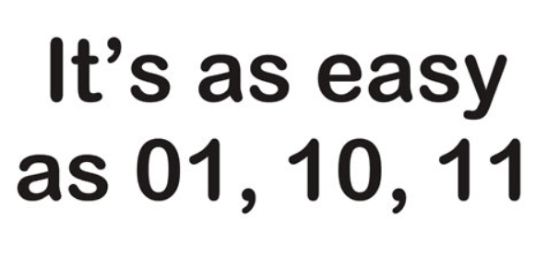
Digital Logic Design
Week 1
Sumaiyah Zahid

Slide 3
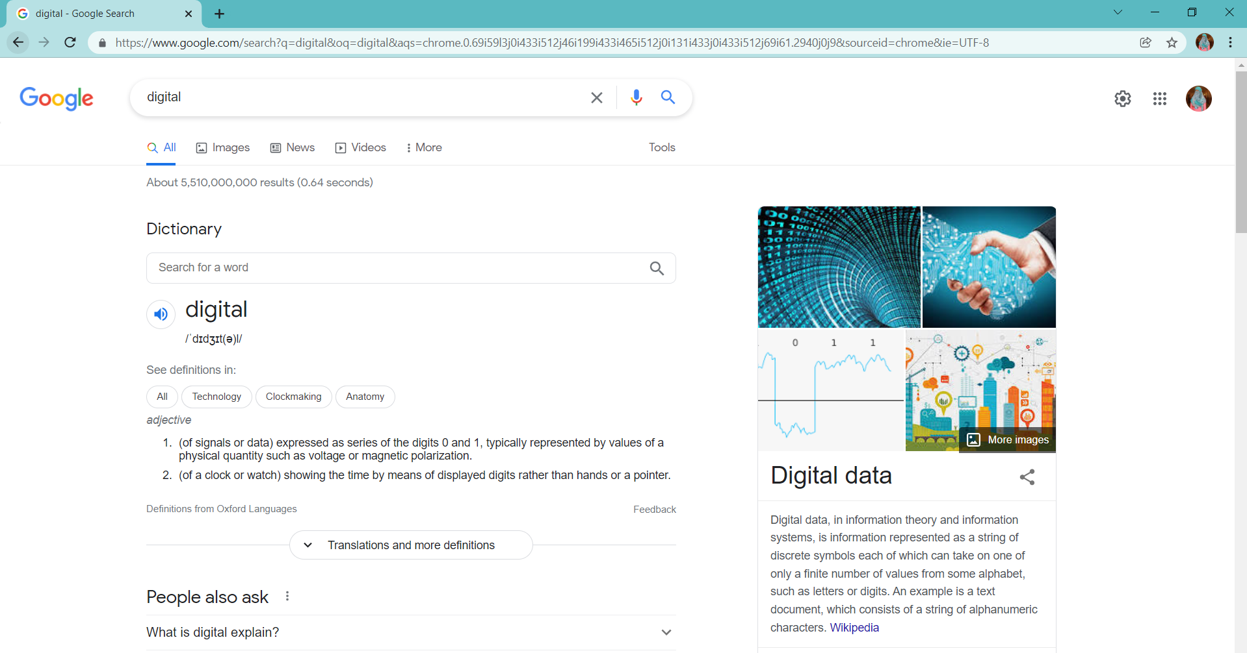

Slide 4
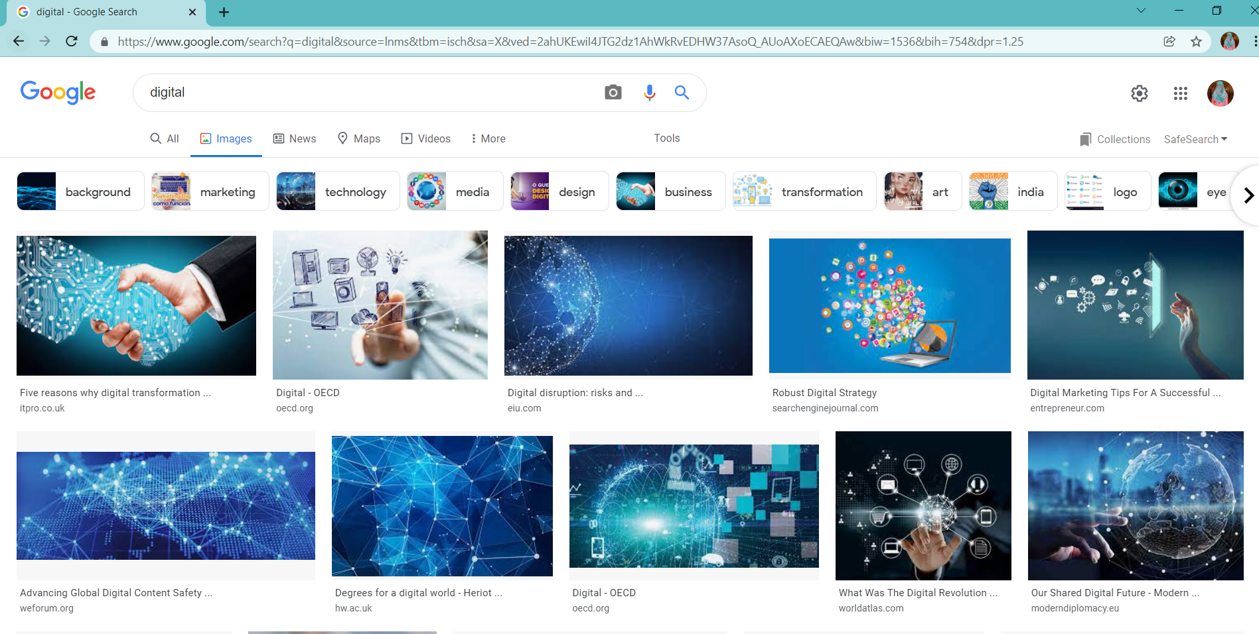

Slide 5
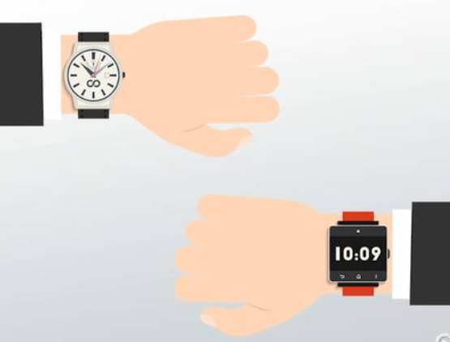
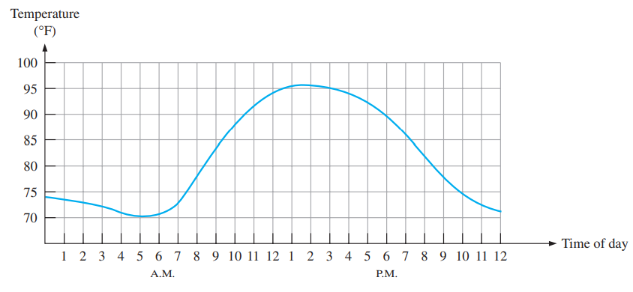
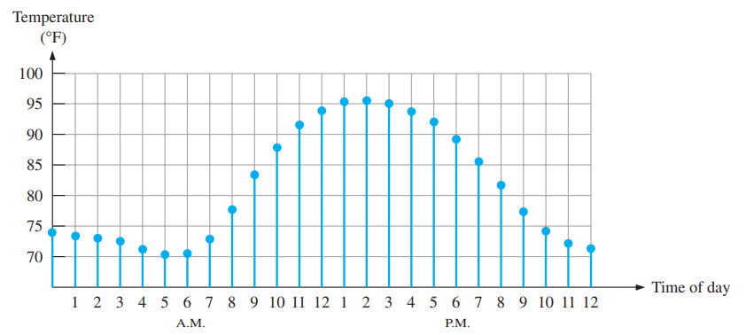
Analog Vs Digital
An analog quantity has continuous values.
A digital quantity has discrete set of values.

Slide 6
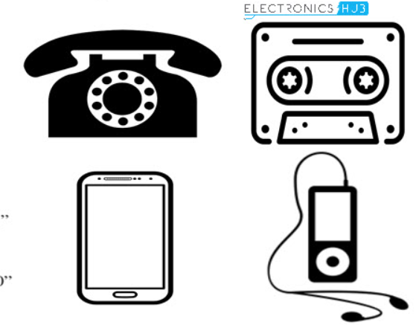
Digital Advantage
It can be processed and transmitted more efficiently.
It can be stored more compactly and reproduced with greater accuracy.
Less prone to noise.

Slide 7
Each Smart Watch is a Digital Watch.
Each Smart Phone is a Digital Phone.
Each Smart City is a Digital City.
SMART is just advanced DIGITAL.

Slide 8
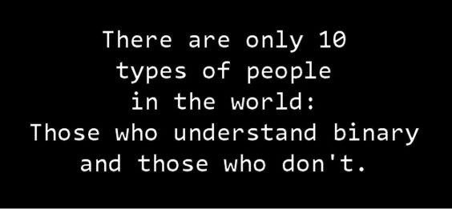
Binary Digits
There are two digits in the binary system, 1 and 0.
Each digit is called a bit.
Binary + Digit = Bit

Slide 9
Binary Digits
Positive Logic:
High = 1
Low = 0
Negative Logic:
High = 0
Low = 1

Slide 10
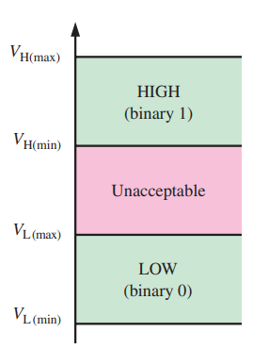
Logic LEvels
The voltages used to represent a 1 and a 0 are called logic levels.’
LOW = < 0.8 V
HIGH = 2V - 3.3 V

Slide 11

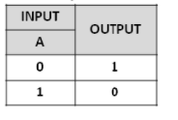

Logic Gates - NOT Gate
!

Slide 12
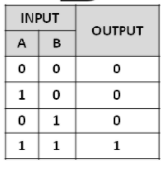

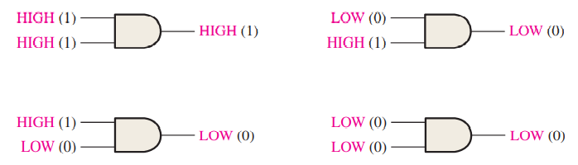
Logic Gates - AND Gate
&&

Slide 13
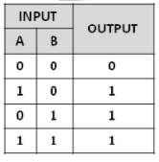

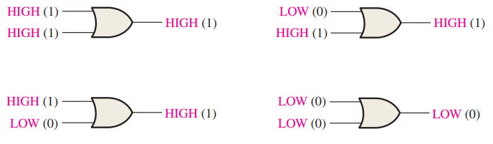
Logic Gates - OR Gate
||

Slide 14
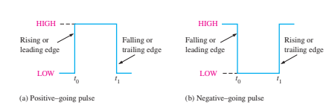
Digital Waveforms
It consist of voltage levels that are changing back and forth between the HIGH and LOW levels or states.

Slide 15
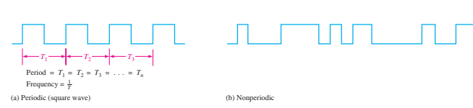
Periodic and Non-Periodic Waves
A periodic pulse waveform is one that repeats itself at a fixed interval, called a period (T).
The frequency ( f ) is the rate at which it repeats itself and is measured in hertz (Hz).

Slide 16


Waveform Characteristics
The frequency ( f ) of a pulse (digital) waveform is the reciprocal of the period.
Duty Cycle: It is the ratio of the pulse width (tW) to the period (T).

Slide 17
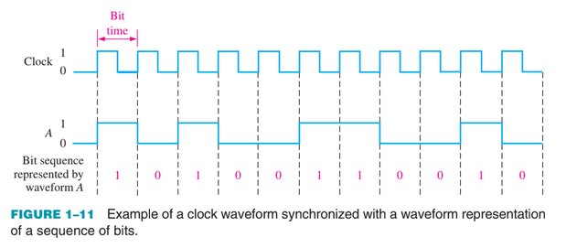
Clock
The clock is a periodic waveform in which each interval between pulses (the period) equals the time for one bit.

Slide 18
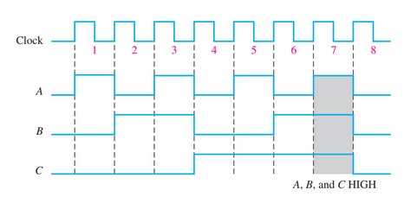
TIMING Diagrams

Slide 19
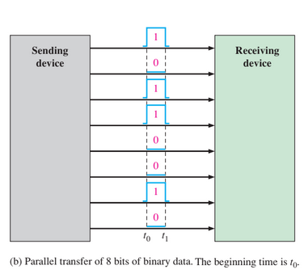
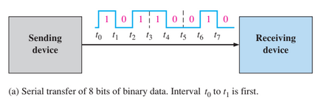
Data Transfer

Slide 20
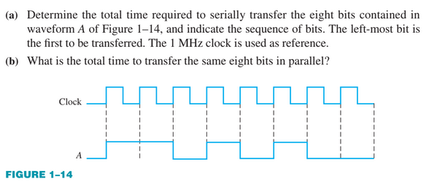

Slide 21
